Slide 1
Introduction to Parent Accounts

Slide 2
Edmodo for Parents
Parent accounts on Edmodo are a great way to enable parents to stay up to date on their child’s classroom activities, assignments, grades and school events.
Parents can:
View any posts you have marked “public” within their student’s groups
View their student’s homework assignments, due dates and grades
Receive updates on class and school events via email or text notifications

Slide 3
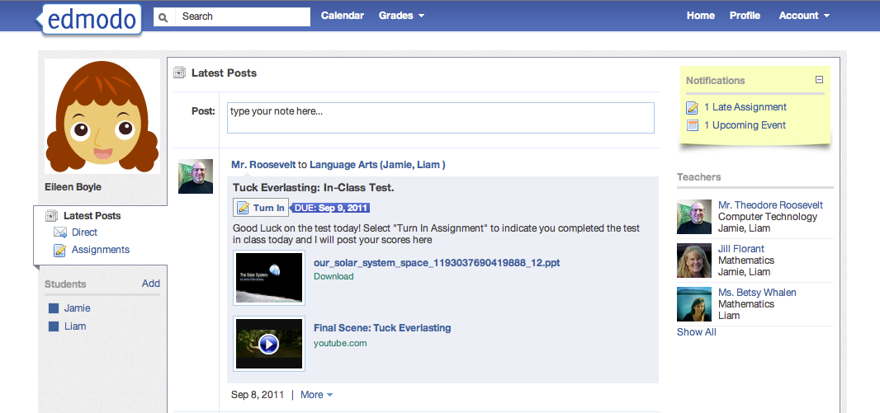
Parent Account Overview
Parents can view posts sent to the parent group
View notifications
and teachers
Filter by student and add additional students

Slide 4
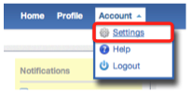
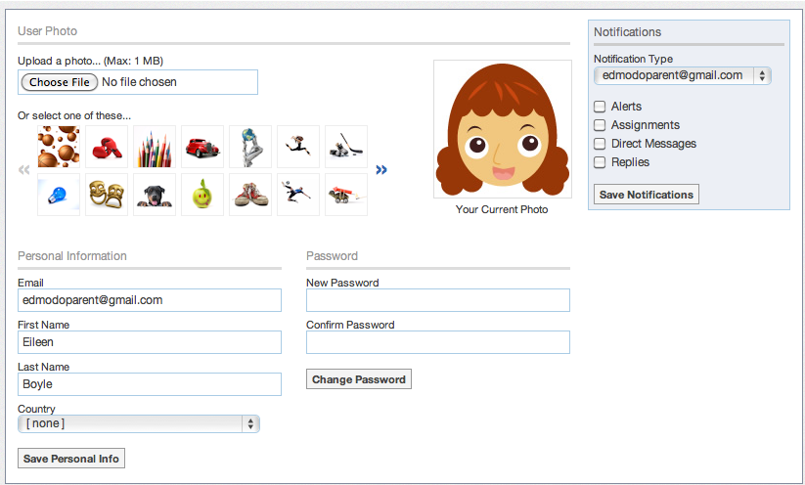
Account Settings
Set text or email notifications
Upload a profile photo
Change password and personal information

Slide 5
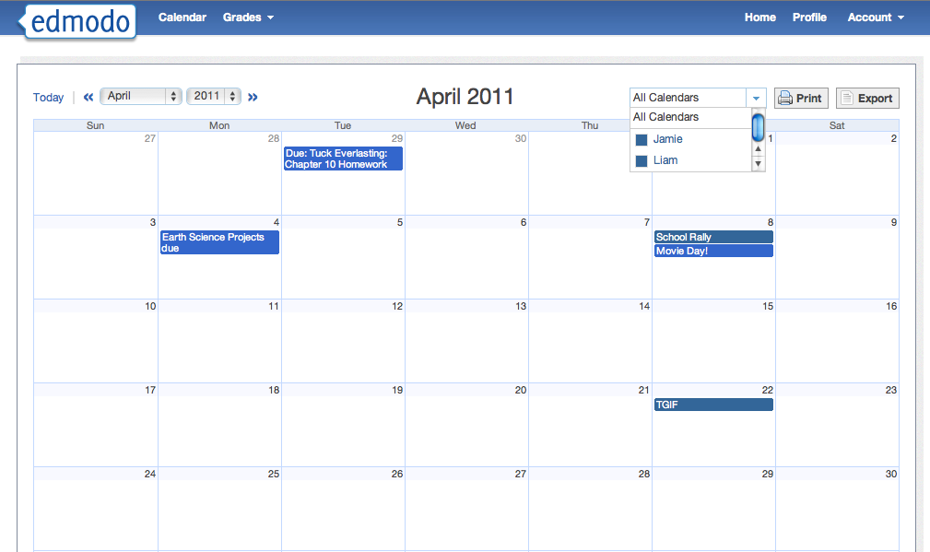
Calendar
Filter calendar by student
View past and upcoming months

Slide 6
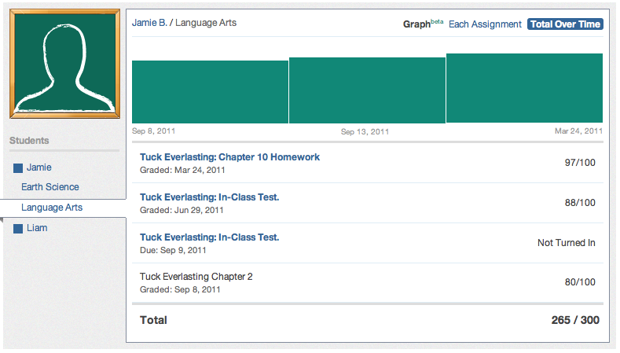
Gradebook
Filter by student and class
Select an assignment to view teacher comments/feedback

Slide 7
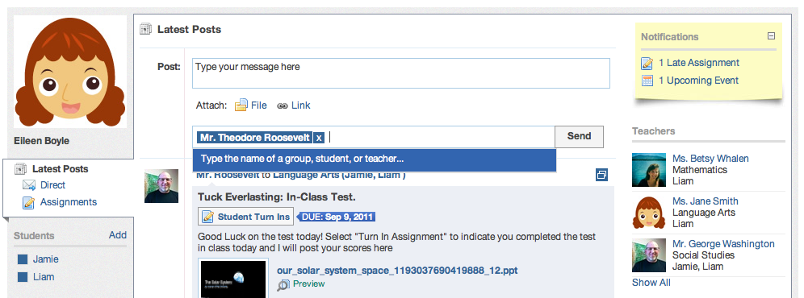
Sending Messages
Send direct messages to teachers

